Slide 1
Undergraduate Student Research In engineering
USRE

Slide 2
Research Opportunities
Student Mixers
Networking
Professional Development
ESTD 2017

Slide 3
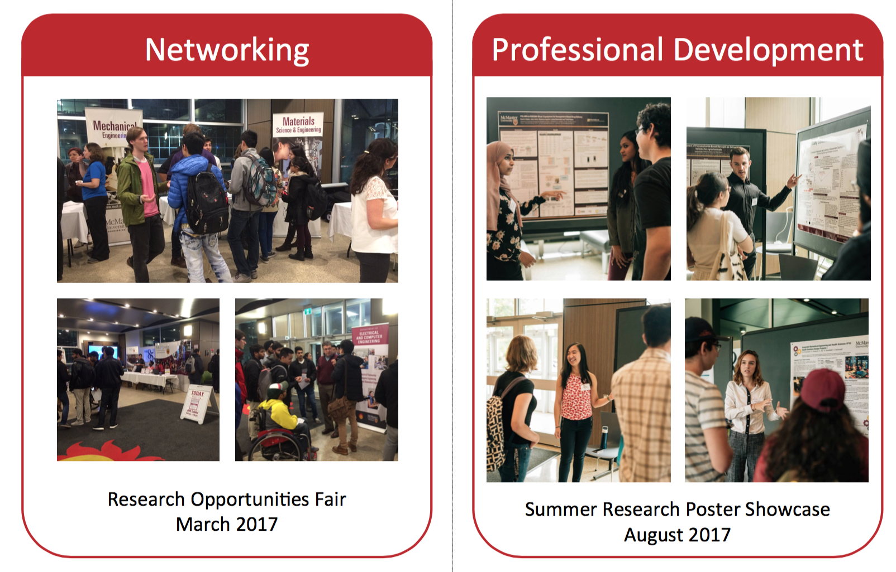

Slide 4
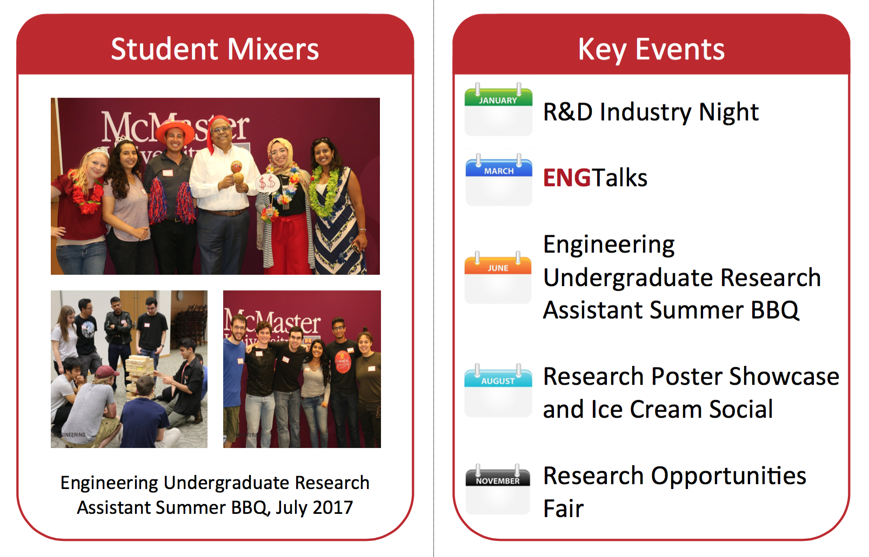

Slide 5
My Path to graduate studies
Sophia Emerson
Chemical and Bioengineering, Level V

Slide 6
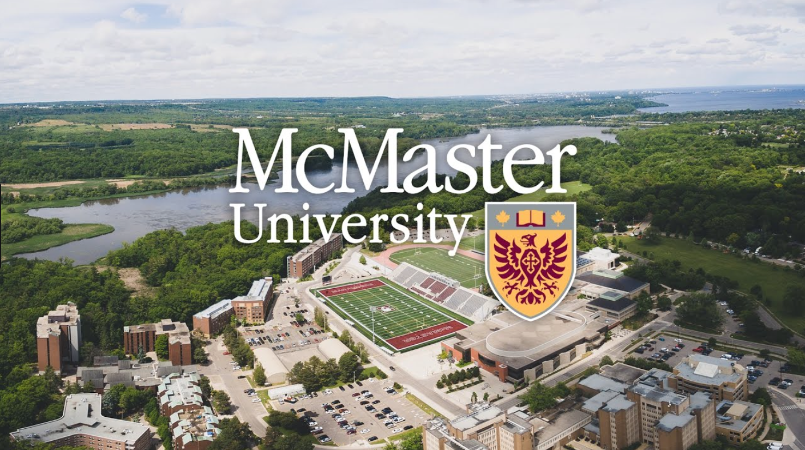
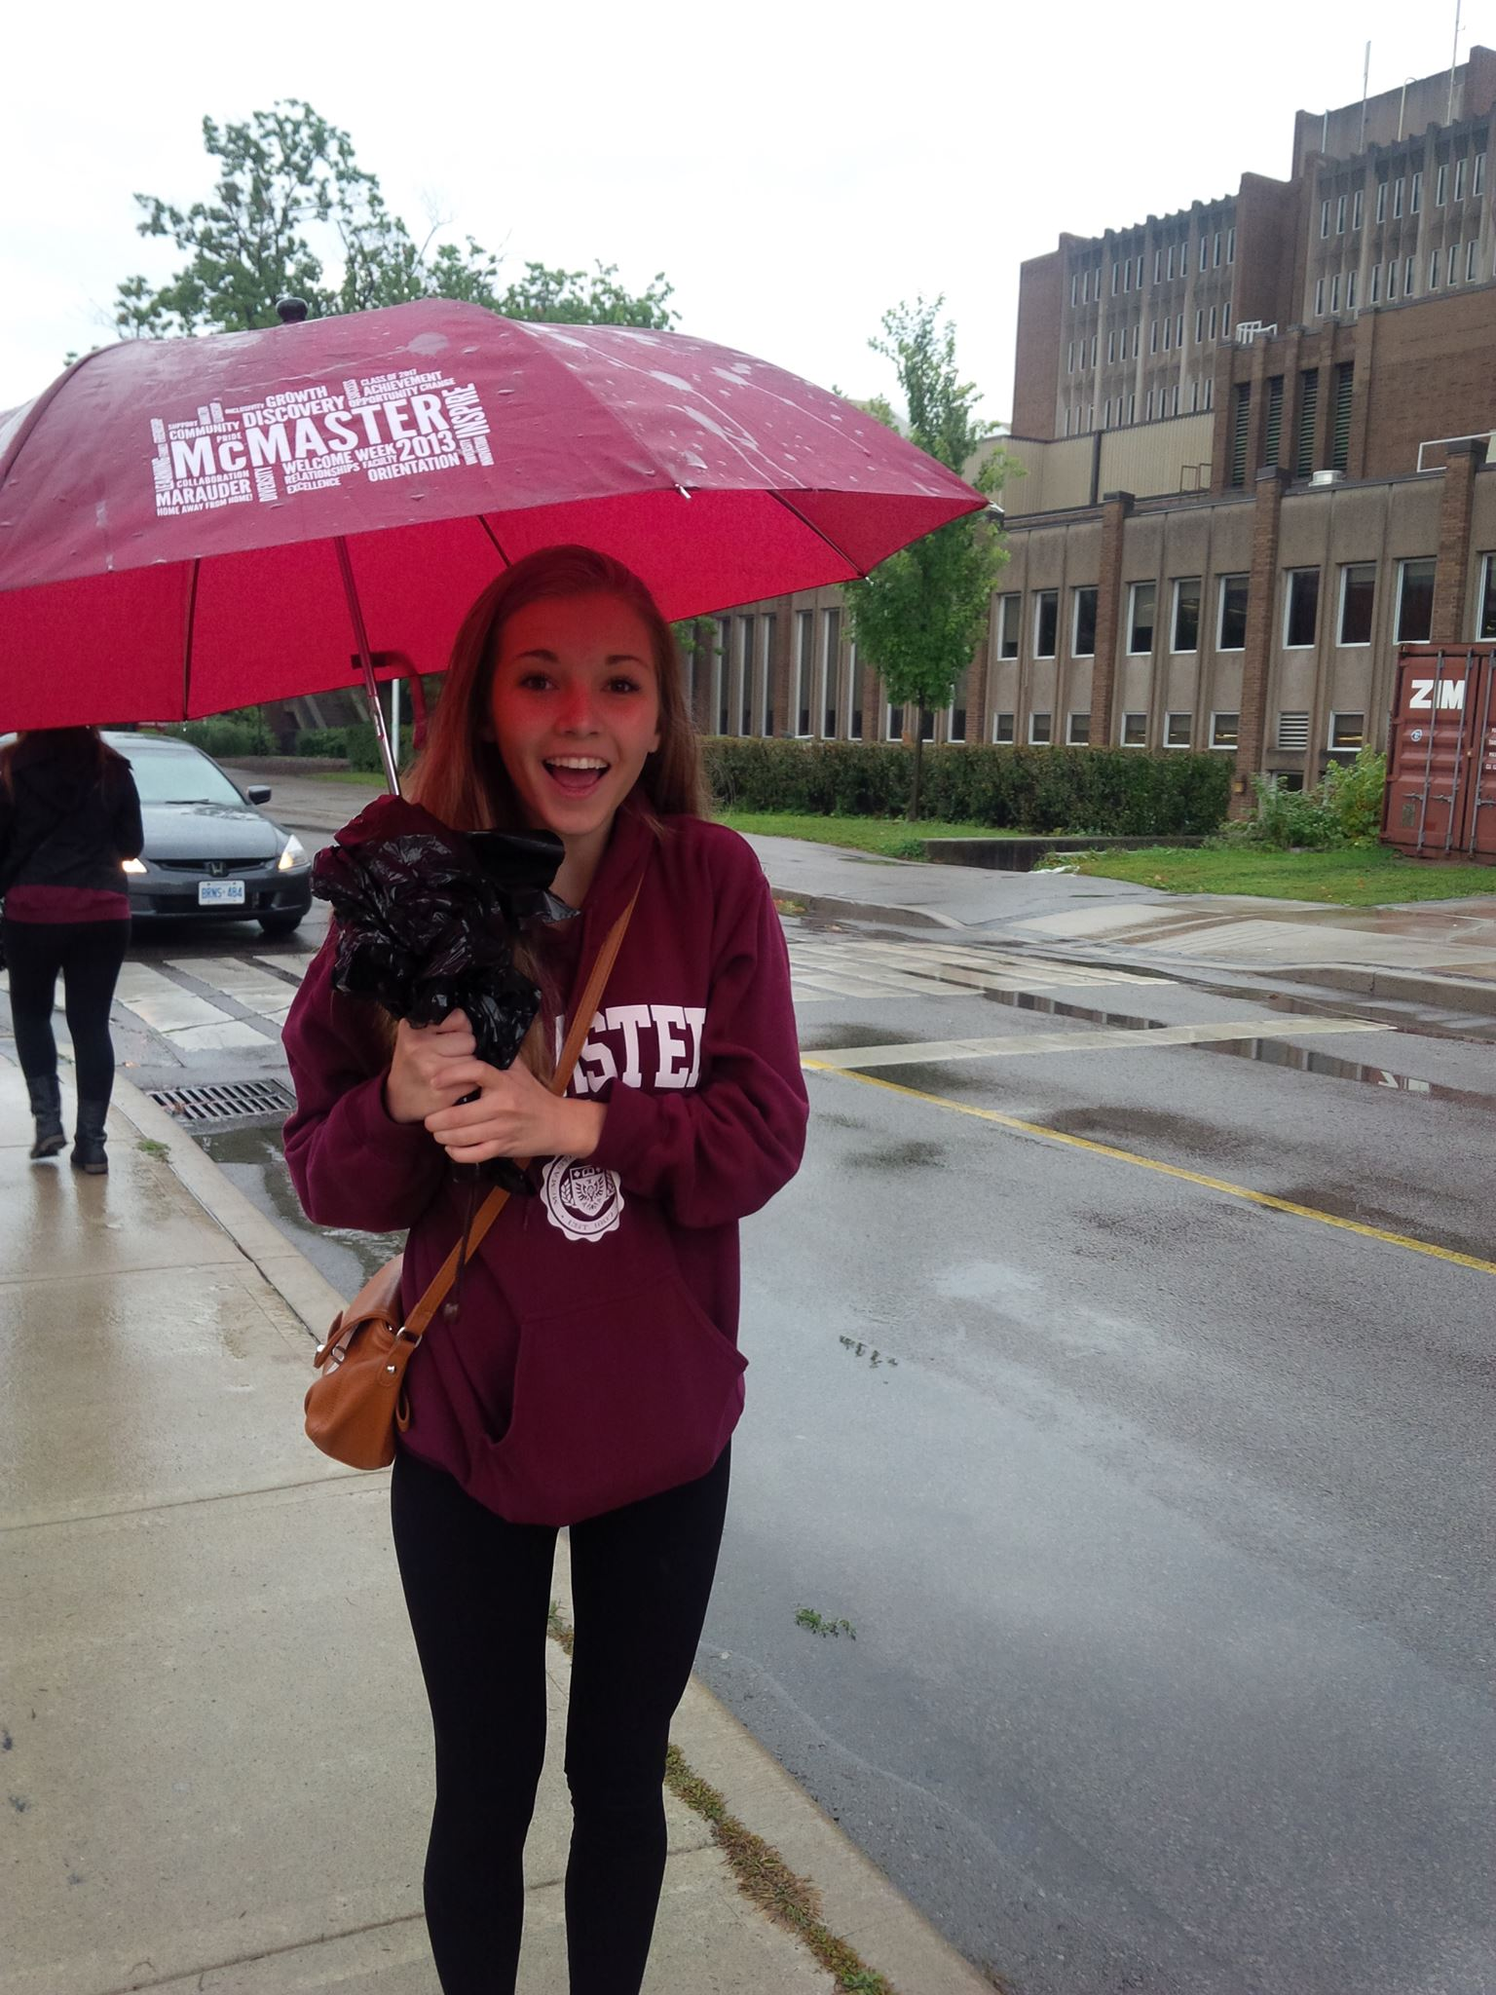
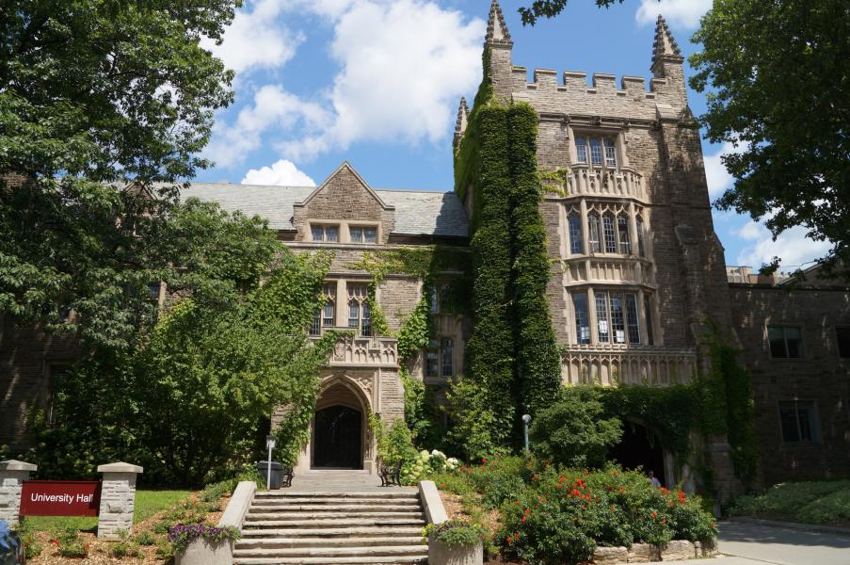
Frosh Week, Sept. 2013

Slide 7
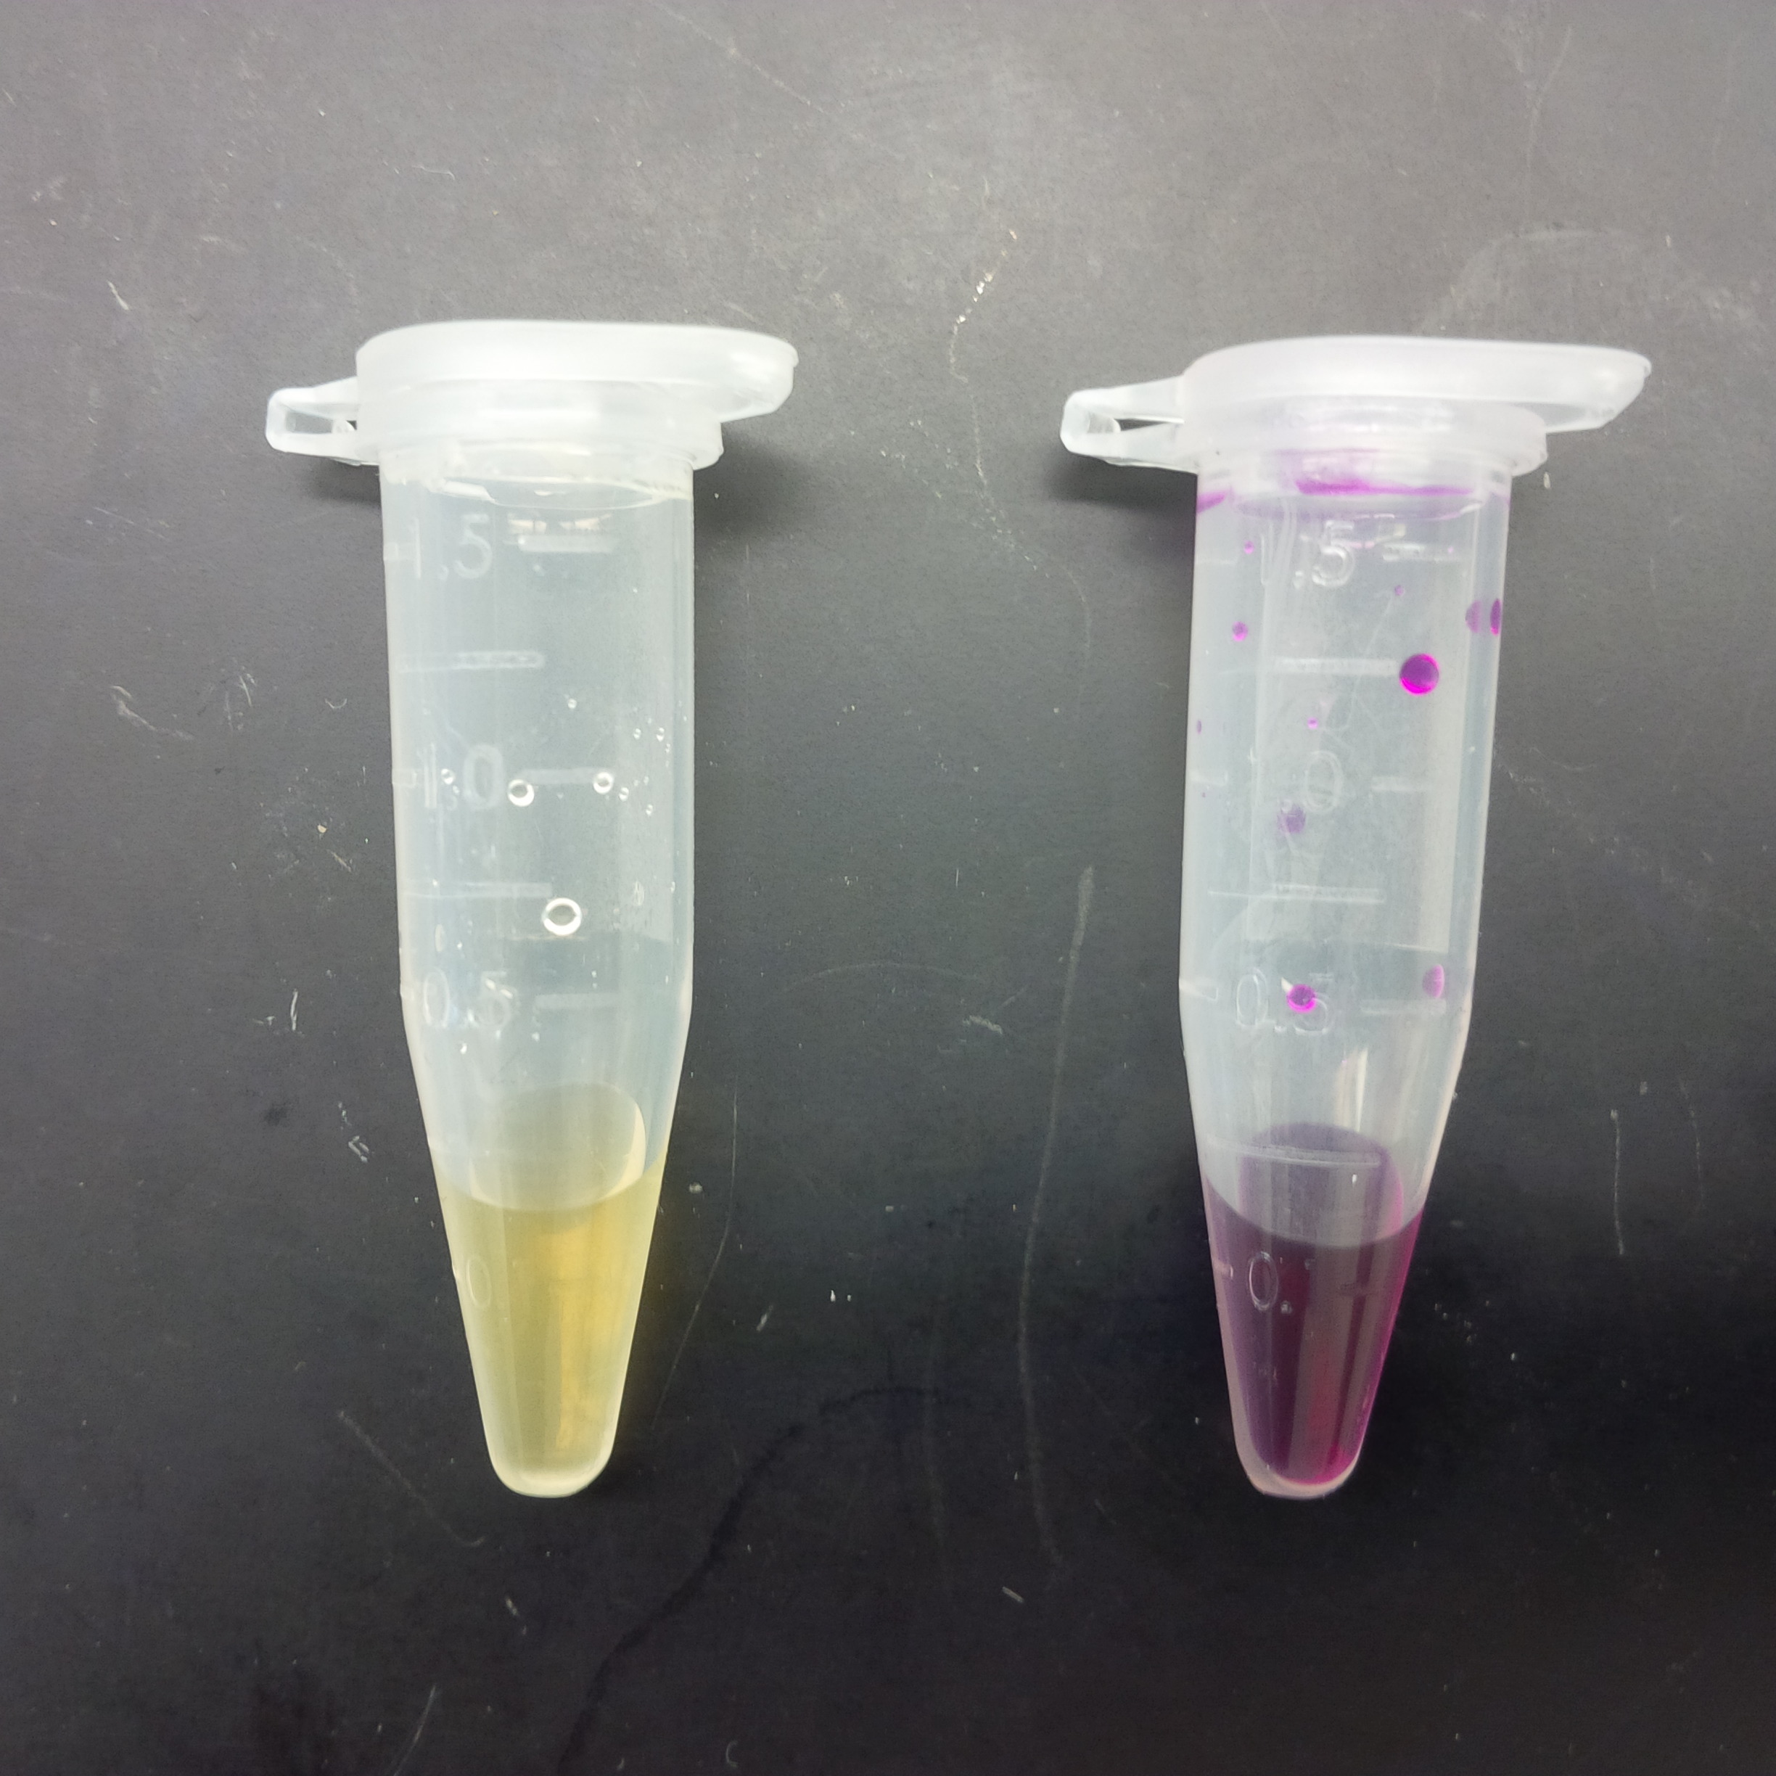
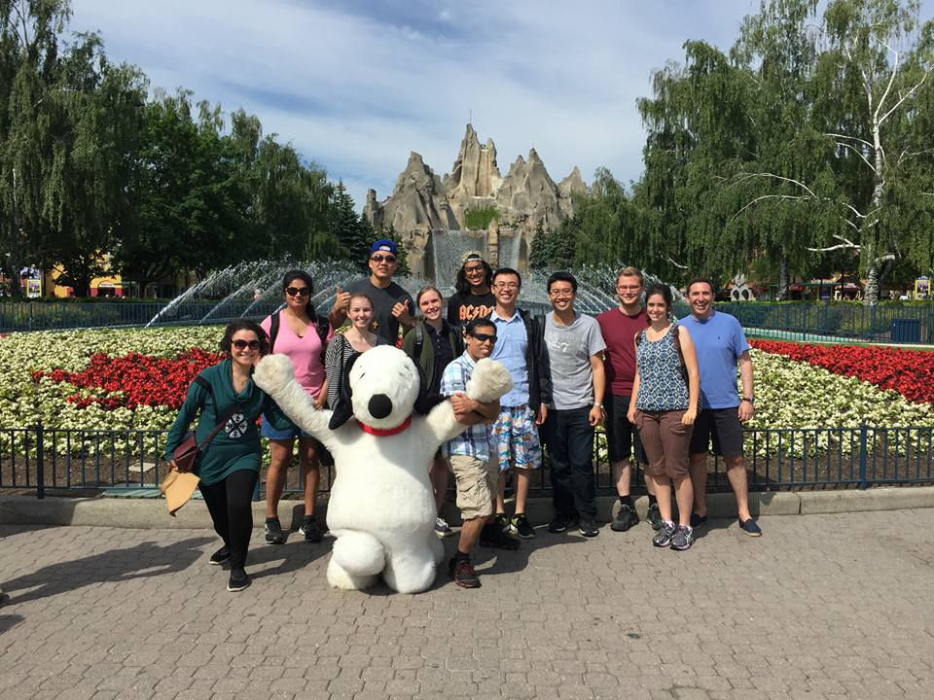
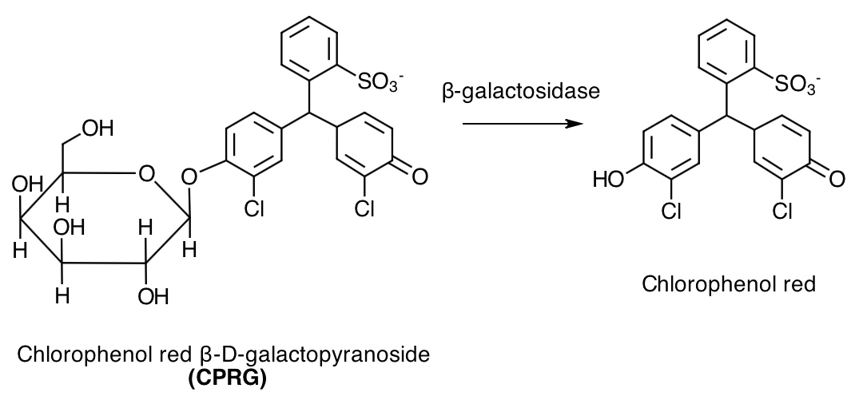
May 2015: First Research Position in Dr. Carlos Filipe’s Lab
Heavy Metal Detection Sensors
0 min
5 min

Slide 8
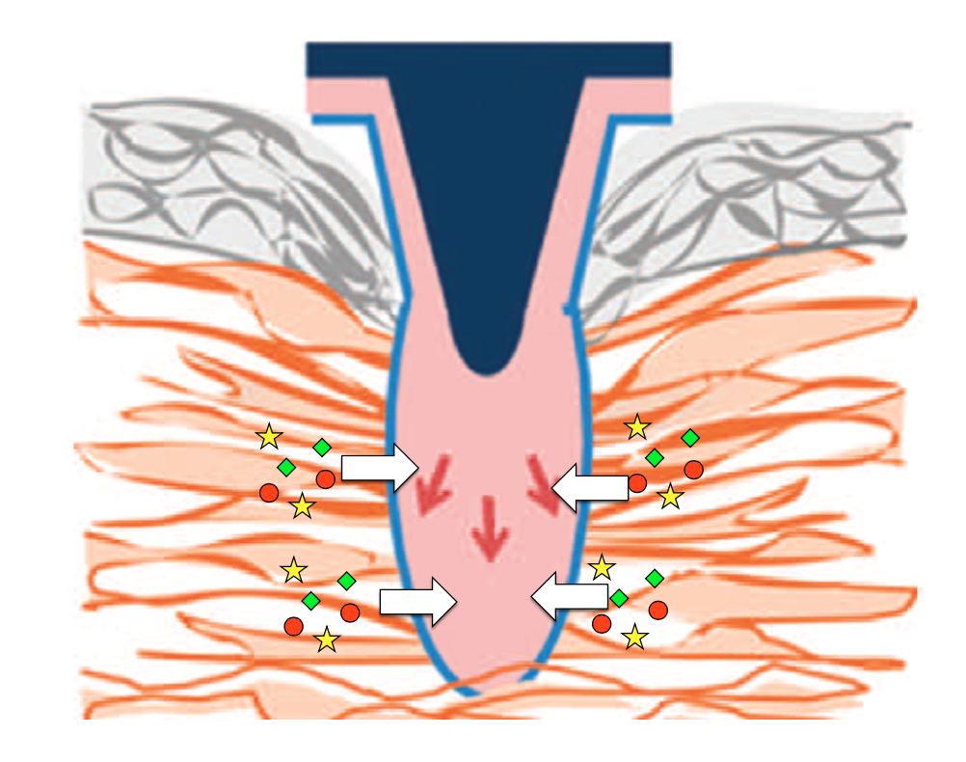
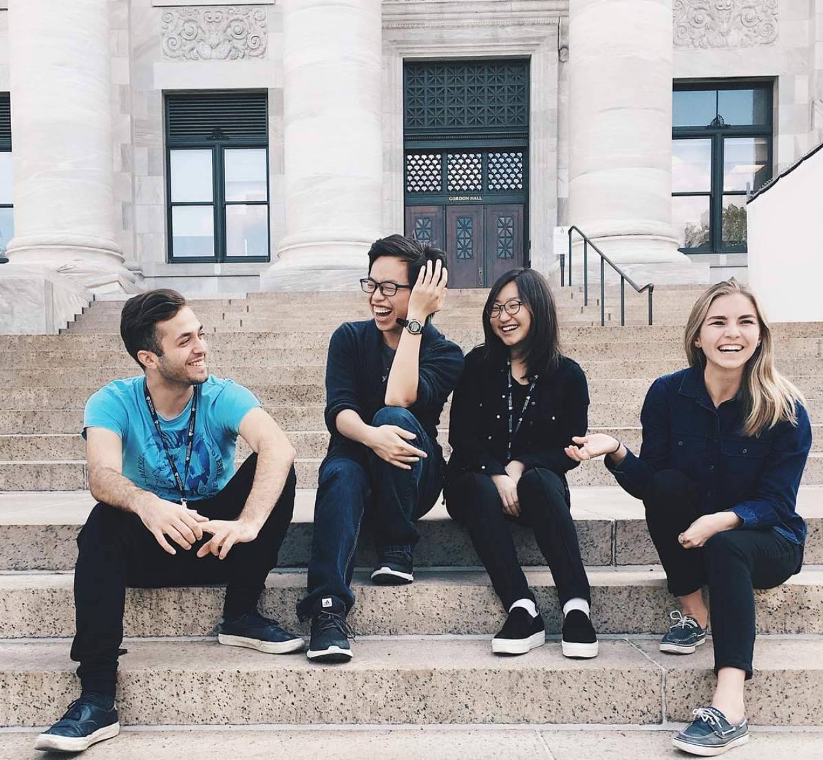
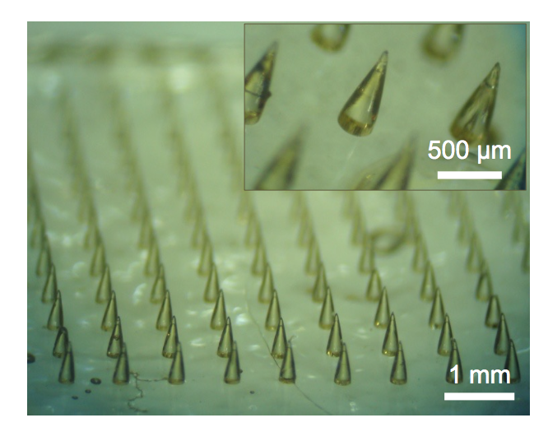
May 2017: Research Term with Harvard-MIT Division of Health Science and Technology
Minimally Invasive Skin Biopsies

Slide 9
How to Apply to Graduate Schools
Sophia Emerson
Chemical and Bioengineering, Level V

Slide 10


Masters of Engineering or Masters of Applied Science in Engineering?
Short Answer: Depends on your career goals!
M.Eng | M.ASc
Focus on coursework Usually involves a capstone engineering project and report Typically 12 months to completion Aimed towards equipping students with further technical knowledge for fieldwork | Focus on research-based work Typically requires a thesis for completion Generally 24 months to completion Prepares students for a Ph.D. after completion

Slide 11
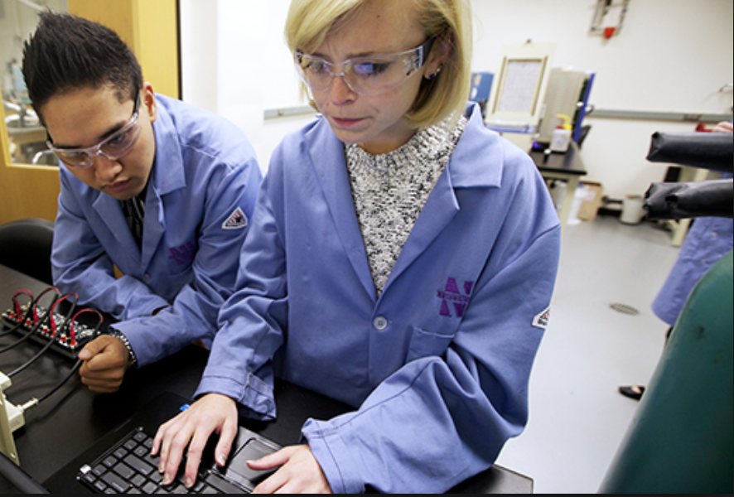
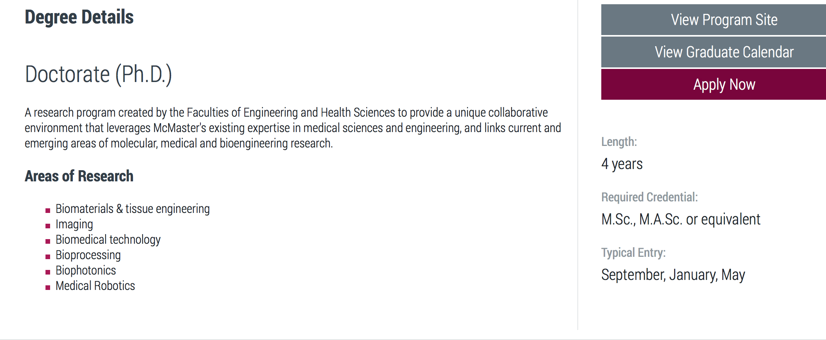
Doctor of Philosophy (Ph.D.)

Slide 12
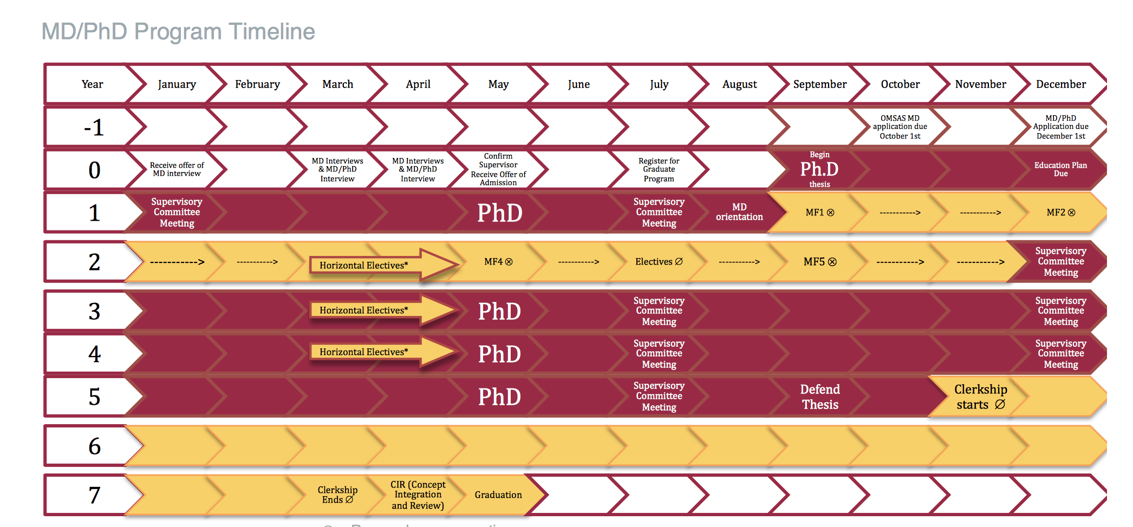
M.D/ Ph.D. Programs
Notes:
Must be accepted in to medical school first → whole other ball game that Im not going to talk about in this presentation (you apply to med school and PhD at the same time… separate applications)
Mcmaster offers it to 3 students per year
Also offered at UofT, Uottowa, UBC, Western, McGill, Queens

Slide 13






Some Biomedical/Bioengineering Graduate Programs in Canada
School of Biomedical Engineering
Institute of Biomaterials and Bioengineering
School of Biomedical Engineering
Biological and Biomedical Engineering (BBME)
Biomedical Engineering (M.E.Sc)
School of Biomedical Engineering

Slide 14
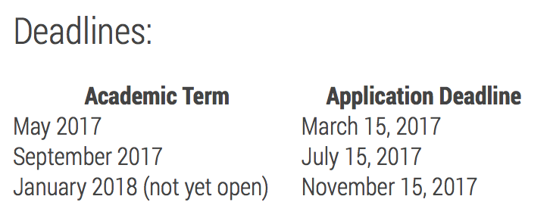
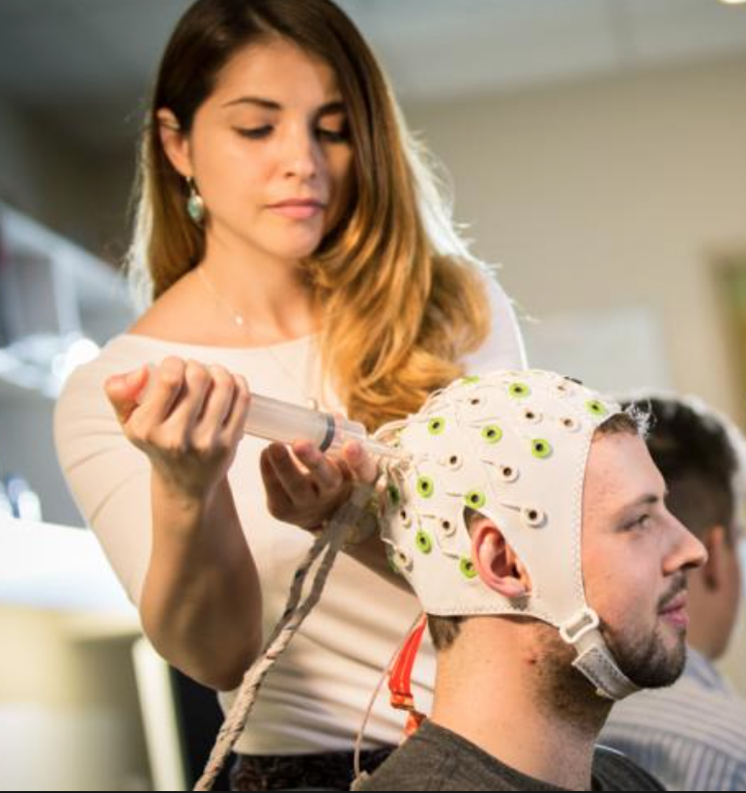
M.A.Sc. Application Requirements
Example: McMaster School of Biomedical Engineering
Application Checklist:
Resume
Certified copy of transcript
Statement of interest
Two academic letters of recommendation

Slide 15
Application Checklist:
Resume
Certified copy of transcript
Statement of interest
A
Two academic letters of recommendation
Typically average from final two years of undergrad is considered
McMaster requests a B+ Average
1-2 page letter of intent
Preferably those who can speak to your academic abilities and research experience

Slide 16
Finding a Supervisor
Review profiles online and read a couple of their publications to familiarize yourself with their work
Write a brief email to them indicating your awareness of their research and how it fits with your interests
BE SPECIFIC! Refer to their publications
Keep it succinct (<200 words)
Let them know your intetion to apply to their graduate program and interest in working with them
Tell them a couple of strong points about your background and who you’ve worked with on research projects
Ask if its OK to refer to them as a prospective supervisor on your application
For further information: https://www.mcgill.ca/gradapplicants/research-supervision/connecting-supervisor

Slide 17
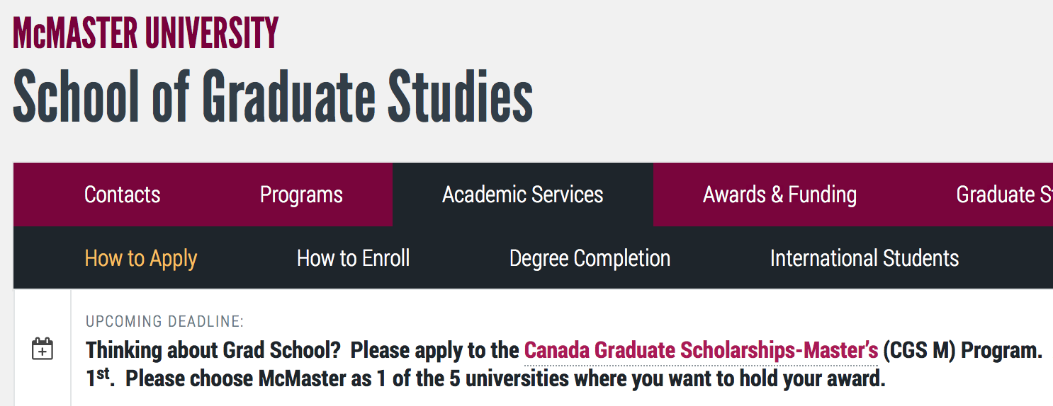
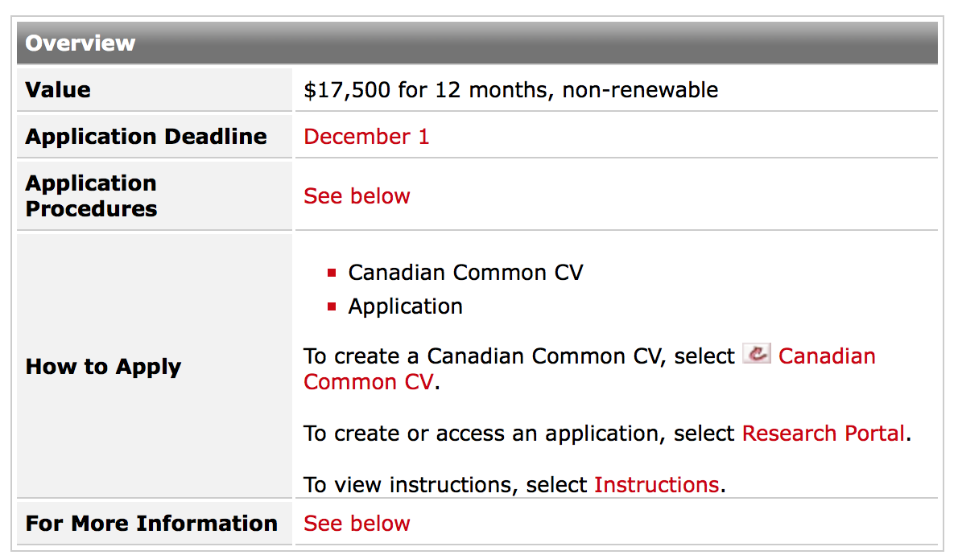
Get Your Own Funding
A- Average in final two years of study is required

Slide 18
Additional Considerations for Graduate School

Slide 19
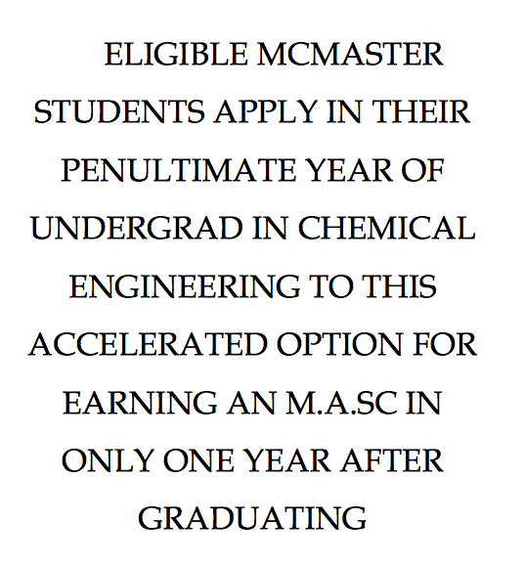
Accelerated Masters (Chem. Eng.)
Requirements:
Cumulative average of 9.5
Sessional average of 10 in final year
Complete 4 months of relevant research in the summer before final year
Complete the Senior Independent Thesis (ChE 4Y04)
Complete a 600 level course in final year
Graduate with a M.A.Sc 16 months after undergrad (May-August)

Slide 20

Graduate Research Days 2018
http://gradstudies.engineering.utoronto.ca/graduate-research-days/
February 22nd – 24th
→ Travel expenses and hotel accommodations covered by UofT
Meet with potential supervisors based on your research interests
Tours of UofT Engineering’s learning and research spaces
Networking and social events with faculty and staff
Apply online by Friday, January 12th, 2018

Slide 21
Thank You

